Slide 1
An Efficient Parallel Keyword Search Engine on
Knowledge Graphs
A report by Asmita Singh
M.Tech (Analytics), 2019 Autumn Sem
NIT, Delhi

Slide 2
Author(s)
Yueji Yang, Anthony K. H. Tung, Shuang Wu [School of Computing, National University of Singapore]
Divykant Agrawal [Department of Computer Science, University of California at Santa Barbara]
H.V. Jagadish [Department of Electrical Engineering and Computer Science, University of Michigan of Ann Arbor]
About
Title An Efficient Parallel Keyword Search Engine on Knowledge Graphs
Publisher IEEE [35th International Conference on Data Engineering (ICDE)]
Copyright Date 2019

Slide 3
Keyword-ing
Keyword queries are easy for a non-technical user to specify removing the burden of understanding database structure (or schema) in addition to the burden of learning a query language.
The query only comprises keywords; the corresponding output is one or more subgraphs.
The solution technique is, roughly, to identify matches for each keyword individually and then to combine matches based on an appropriate notion of proximity (such as shortest join path).

Slide 4
Problem
Evaluating a keyword query is usually significantly more expensive than evaluating an equivalent selection query, since
the query specification is less complete, and
many alternative answers have to be considered by the system, requiring considerable effort to generate and compare.
In particular, searching of knowledge graphs is gaining popularity.
As knowledge graphs often comprise many millions of nodes and edges, performing real-time search on graphs of this size is an open challenge.

Slide 5

Knowledge Graph
A Google approach introduced in 2012

Slide 6
A tough nut
There can be many possible join paths between any pair of matches and combinations of paths must be considered, keyword query evaluation is typically expensive.
“Interactive” timing turns out to be challenging, particularly as the size of the database increases, efficiency issues become particularly challenging for knowledge graphs, which are often very large today.

Slide 7
GST (Graph Steiner Tree)
Data structure commonly used, top-k answers for GST consists of top-ranked trees (according to some scoring function) embedded in the original data graph.
Nodes containing the same keyword form a group and the answer is a tree embedded in the data graph and covers one leaf node from each group.
Unfortunately, it turns out to be very difficult for coming approaches.

Slide 8
Approaches
As the size of knowledge graphs grows rapidly, the efficiency issues naturally come up.
Unfortunately, there are few approaches that can respond to keyword queries in real-time on a KB with hundreds of millions of edges.
Current approaches typically adopt the GST model, including BANKS-I, BANKS-II and BLINKS.
Since GST is known to be NP-hard and there exists no polynomial approximate algorithm with constant approximation ratio, the above methods only conceptually approximate GST without any error bound.

Slide 9
Solve parallelly?
Having witnessed great advances in computer hardwares (e.g. multi-core CPUs and GPUs), inspired to think whether can make use of parallel computational power of modern hardwares to address the efficiency issues.
To make matters concrete, focused on one specific important knowledge graph, Wikidata Knowledge Base.
Implemented an online query service and name it WikiSearch.

Slide 10
Birth of Central Graph
In view of the hardness of traditional keyword search models, we are motivated to seek a solution to keyword search problem that can work in real time.
Therefore, we are motivated to develop a new model, called Central Graph, which can work in parallel and still return meaningful compact answers.

Slide 11
Central Graph
Different from the typical GST methods that produce trees as answers, this model returns graphs as answers.
As can be seen, graph-shaped answers can convey much more information with fewer repetitions.
In addition to the efficiency improvement, our model is particularly suitable searching knowledge bases which typically have richness and heterogeneity of information.

Slide 12
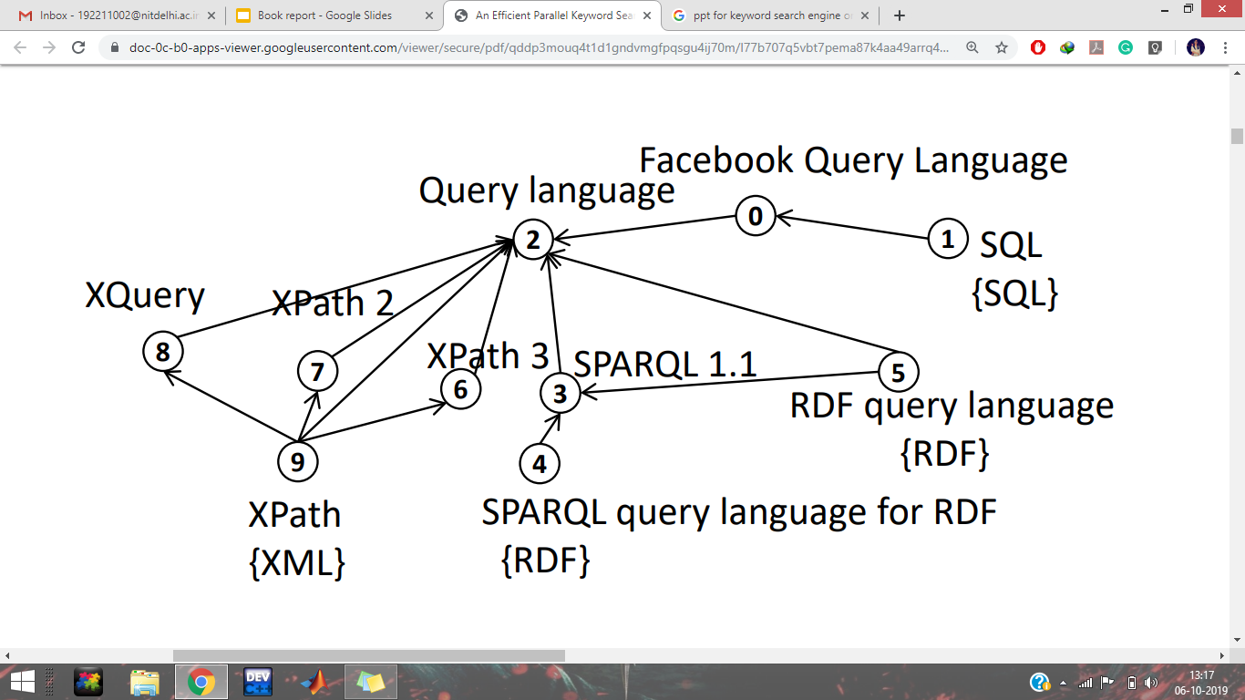
Fig. 1: Example answer graph by our proposed approach for input keywords XML, RDF, SQL. Edges’ types are omitted. For tree-shaped answers rooted at v2, there are multi-paths from keyword nodes, four paths from v9 and two from v4 and v5. Different combination of these paths give different tree answers, which tend to be repetitive.

Slide 13
Graph vs tree
For example, as shown in Fig. a graph-shaped answer can not only include cycles (from v9 to v2), but also admit more than one node containing the same keyword (eg. v4 and v5 containing “RDF”).
It needs several tree-shaped answers to convey the same information included in such a graph answer.

Slide 14
Related Work
Early works on keyword search, like DBXplorer and Discover, conduct a BFS over the schema graph of tables in targeted relational databases.
ObjectRank is an authority-based method and the output is top-k relevant nodes.
BANKS-I, BANKS-II and BLINKS model keyword search problem by approximating Group Steiner Tree (GST) Problem.
There are a few works trying to harness parallelism, they mainly focus on RDBMS or XML databases.
Aditya et al.propose a backward search algorithm, which is applicable to both relational data and graph data.

Slide 15
There are works, trying to partition graphs and search only necessary parts of a whole graph in the hope of improving scalability problem.
EASE proposes r-Radius Steiner Graph for structure, semi-structure and un-structured datasets.
Kargar et al. point out that EASE may miss some highly ranked r-Radius Steiner Graphs if they are included in some other Steiner Graphs with larger radius.
Qin et al. propose a graph-shaped answers to keyword queries. However, they target at relational datasets and may produce redundant answers.
There are also some other works relevant but orthogonal to keyword search.

Slide 16
Contributions
First, introduce the novel concept of Central Graph to model the answers of a keyword search problem.
The final answers are then pruned and ranked by a keyword co-occurrence based novel approach, called level-cover strategy.
Central Graphs can naturally work in parallel and still return compact answers.
In addition, Central Graphs allow multi-paths from one keyword, leading to much more expressive answers than tree-shaped ones, e.g. Fig. 1.

Slide 17
Second, develop a two-stage parallel algorithm framework that can work on not only multi-core CPUs, but also GPUs.
Our algorithm works in a lock-free way during traversal, which is critical for efficiency.
In the first stage, we find a set of potential Central Graphs in a bottom-up manner starting from nodes containing keywords (keyword nodes).
In the second stage, we extract, prune and select the top-ranked Central Graphs derived from the first stage in a top-down manner starting from Central Nodes, which are centers of respective Central Graphs.

Slide 18
Third, we conduct extensive experiments to evaluate both
efficiency and effectiveness of our proposed approach.

Slide 19
Problem Definition
To enhance the connection between nodes, we model Wiki-data KB as a bi-directed node-weighted graph with both nodes and edges labeled, denoted as G = (V,E), where V and E are the sets of nodes and edges respectively.
We use w_{i} to denote the weight of a node v_{i} ∈ V .
For each edge e_{ij} = (v_{i}, v_{j} ) ∈ E, r_{ij} denotes the relationship (label) of e_{ij}.
In our settings, a BFS instance starts from a set of nodes and proceeds level by level with initial expansion level 0.
Every node can only be hit once in terms of one BFS instance.

Slide 20
A keyword query consists of a set of keywords Q = {t0, t2, .., tq−1}.
For each keyword t_{i}, we denote the set of nodes that contain t_{i} as T_{i}.
In our approach, every keyword t_{i} corresponds to an independent BFS instance B_{i} with source node set T_{i}.
Every BFS instance expands at the same global expansion level.

Slide 21
Hitting Level
Given a BFS instance, B_{b}, the hitting level of a node v_{j} w.r.t. B_{b}, denoted by h^{b}_{j}, is defined as
the first BFS expansion level l where v_{j} becomes a frontier (to expand) in B_{b}.

Slide 22
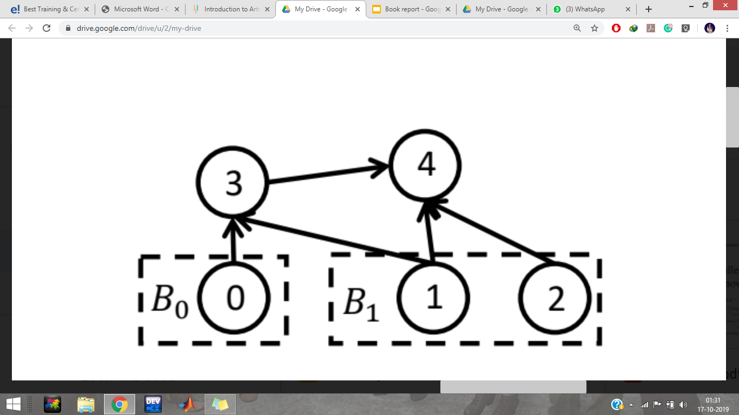
Example As shown in Fig. 2, there are two BFS instances, B₀ starting from v₀ and B₁ from v₁ and v₂.
For B₁, v₁ and v₂ have hitting level h₁¹ = h₂¹ = 0, since they are source nodes and expand at level 0.
h₃¹ = h₄¹ = 1, because v₃ and v₄ are hit at BFS level 0 and become frontiers at level 1.
v₃ will not expand to v₄ in B₁, since v₄ has already been hit.
Fig. 2. A simple example to illustrate definitions.

Slide 23
Hitting Path
Given a BFS instance B_{b}, the hitting path of a node v_{j} is
any expansion path (from source nodes) that hits v_{j} and makes v_{j} a frontier in the next expansion level.
We denote the set of all hitting paths of v_{j} w.r.t. B_{b} as P_{j}^{b} .

Slide 24
Example In Fig. 2, for B₁ and v₄, only v₁ → v₄ and
v₂ → v₄ are hitting paths.
v₁ → v₃ → v₄ is not, since it is not an expansion path.
There is no expansion from v₃ to v₄.
Fig. 2. A simple example to illustrate definitions.

